Slide 1
Capstone 2:
Diabetes Prediction Project
Mengxiao Wang

Slide 2
Addressing Diabetes Prediction through Data Science
01
Purpose of project
Diabetes is a chronic disease that affects millions worldwide. Early detection is important for effective management and prevention.
02
Problem Statement
Many individuals remain undiagnosed due to lack of access to medical testing. There is an opportunity to leverage data science to predict diabetes risk using readily available health data.
03
Opportunity:
Implementing a predictive model can provide early warnings and promote proactive healthcare measures.

Slide 3

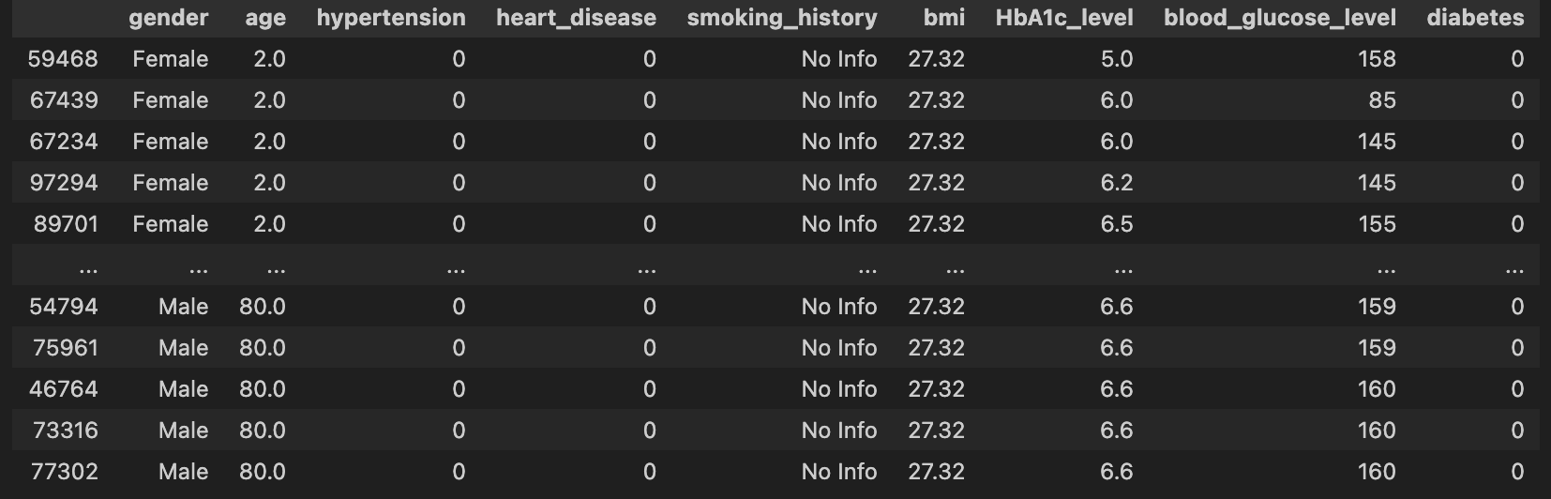
Introduction of the Dataset
The diabetes dataset has 100,000 rows and 9 columns, with 3854 duplicate rows and no null values.
Resource: the Diabetes prediction dataset is a collection of medical and demographic data from patients, along with their diabetes status (positive or negative). Electronic Health Records (EHRs) are the primary source of data for the Diabetes Prediction dataset.

Slide 4
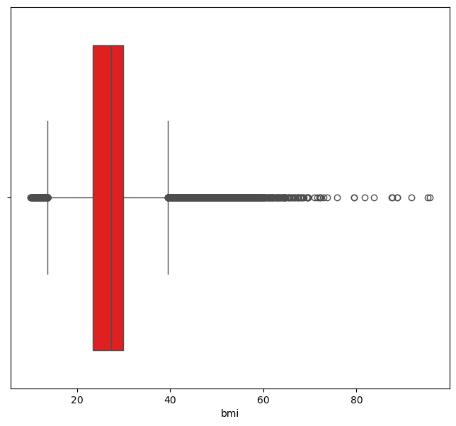
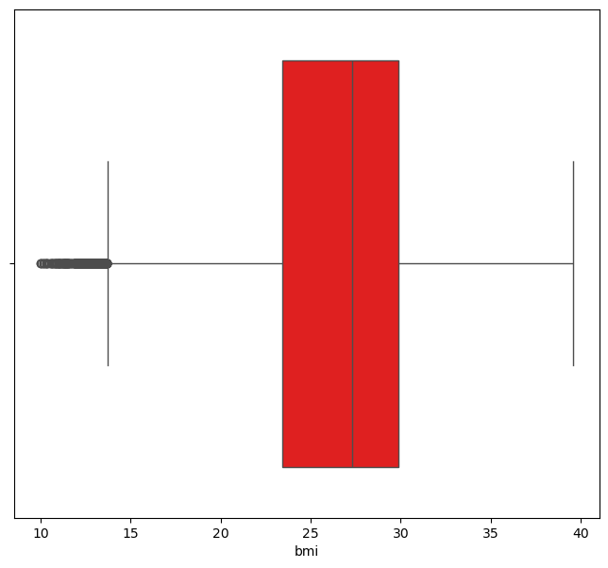
Preprocessing Procedures
Dropped 3854 duplicated rows
Handled outliners for BMI, HbA1c_level and blood_glucose_level
Mapping the smoking_history column for
simplification reason

Slide 5
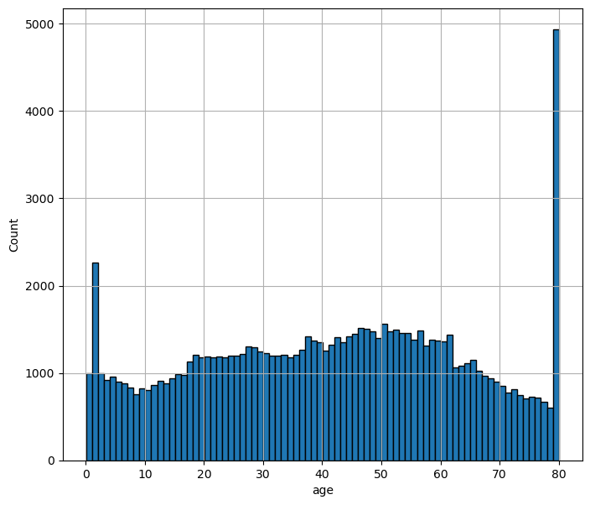
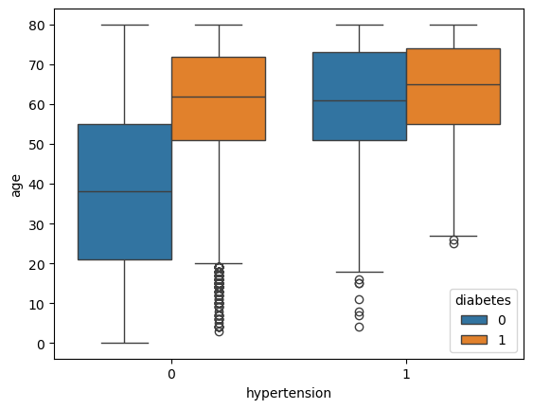
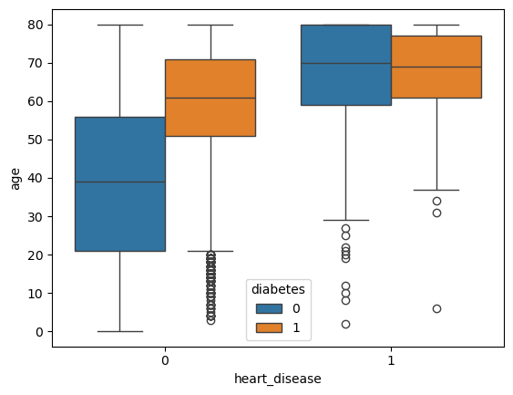
Findings from EDA
Elder people more easy to get hypertension. Also, hypertension may independently contribute to the risk of diabetes regardless of age.
Same with hyperextension, age and heart_disease are strongly related, heart_disease may independently contribute to the risk of diabetes with only a small influence from age.
there are noticeable peaks at age 0 and age 80

Slide 6
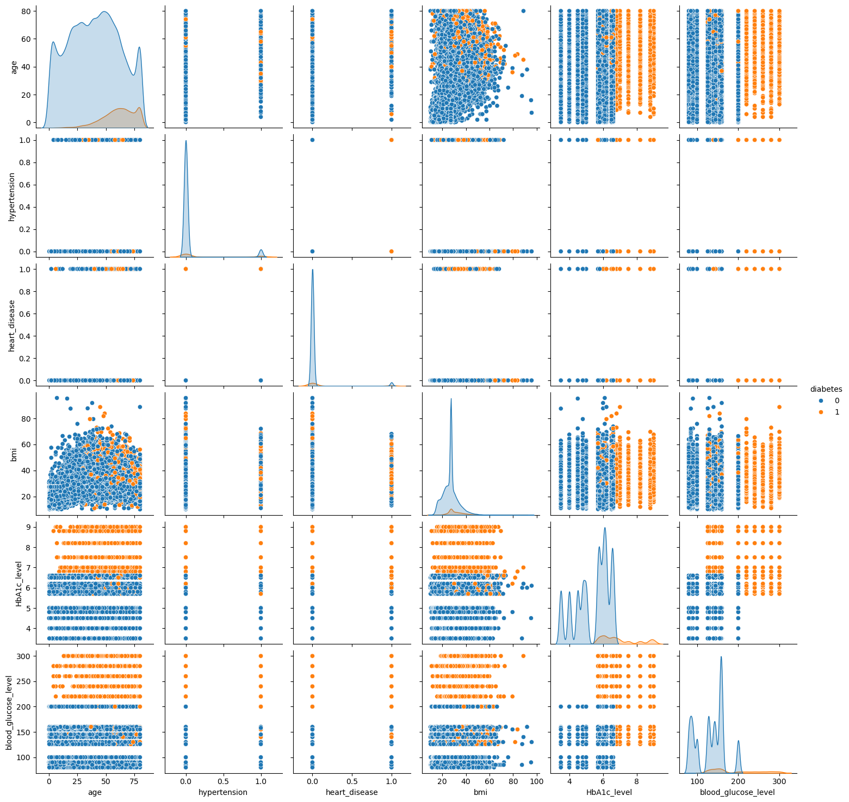
According to the pairplot, we can see that
- Age is a strong predictor of diabetes, with older individuals at higher risk.
- Hypertension and heart disease are associated with a higher prevalence of diabetes.
- BMI, HbA1c level, and blood glucose level are significant indicators of diabetes. Higher values in these features are strongly associated with the presence of diabetes.
I intend to use hypothesis testing to determine whether my assumption is valid.

Slide 7
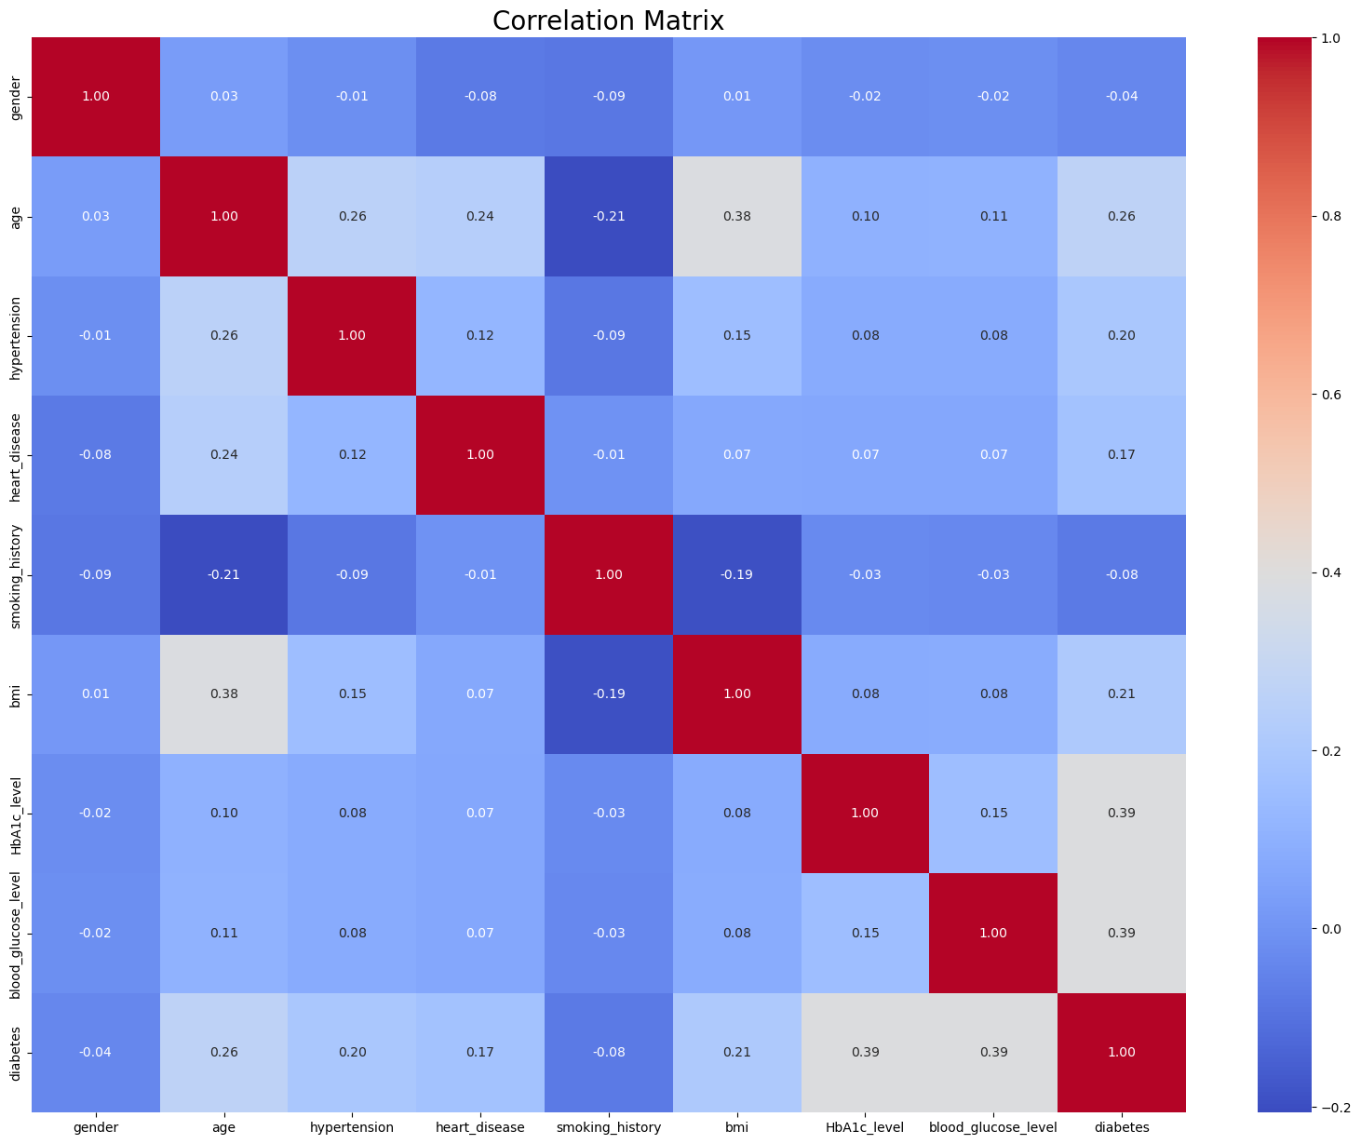
HbA1c Level and Blood Glucose Level have strong correlation with diabetes of 0.41 and 0.42.
Age, BMI and hypertention, heart_disease have moderate correlation with diabetes of 0.26, 0.21, 0.2, and 0.17.
Smoking_histroy and gender have low correlation with diabetes

Slide 8
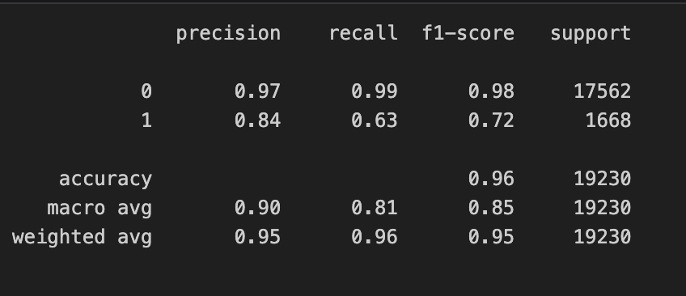
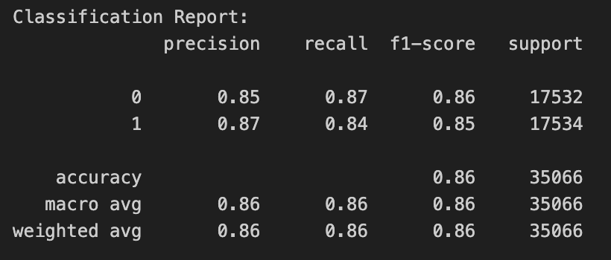
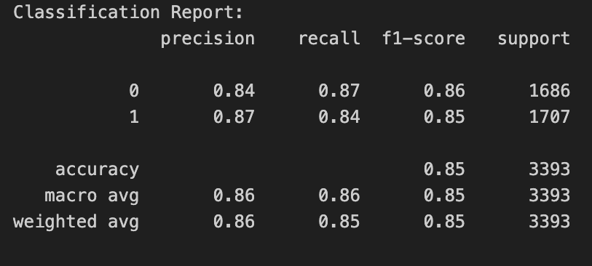
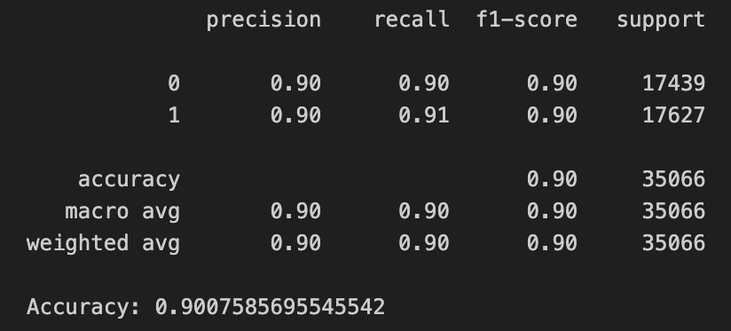
Modeling
Logistic Regression(standardization is used)
My precision, recall, and F1-score are significantly higher for individuals without diabetes compared to those with diabetes It is because my dataset is not balanced. Therefore, I need to implement upsampling to address this issue.
After upsampling
After downsampling
After smote

Slide 9
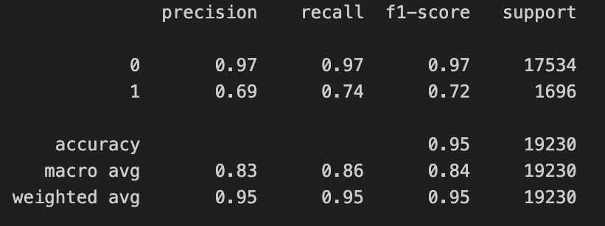
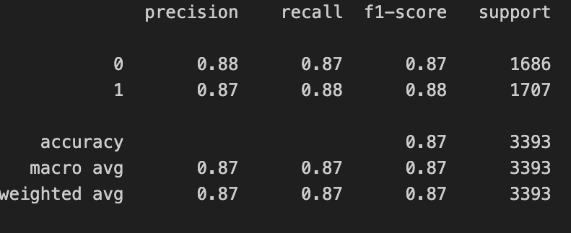
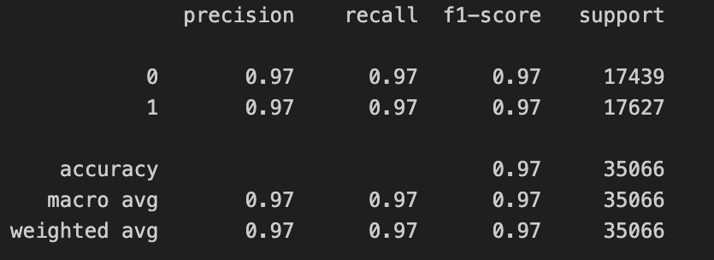
Modeling
Decision Tree
Original classification_report
After downsampling
After Smote

Slide 10
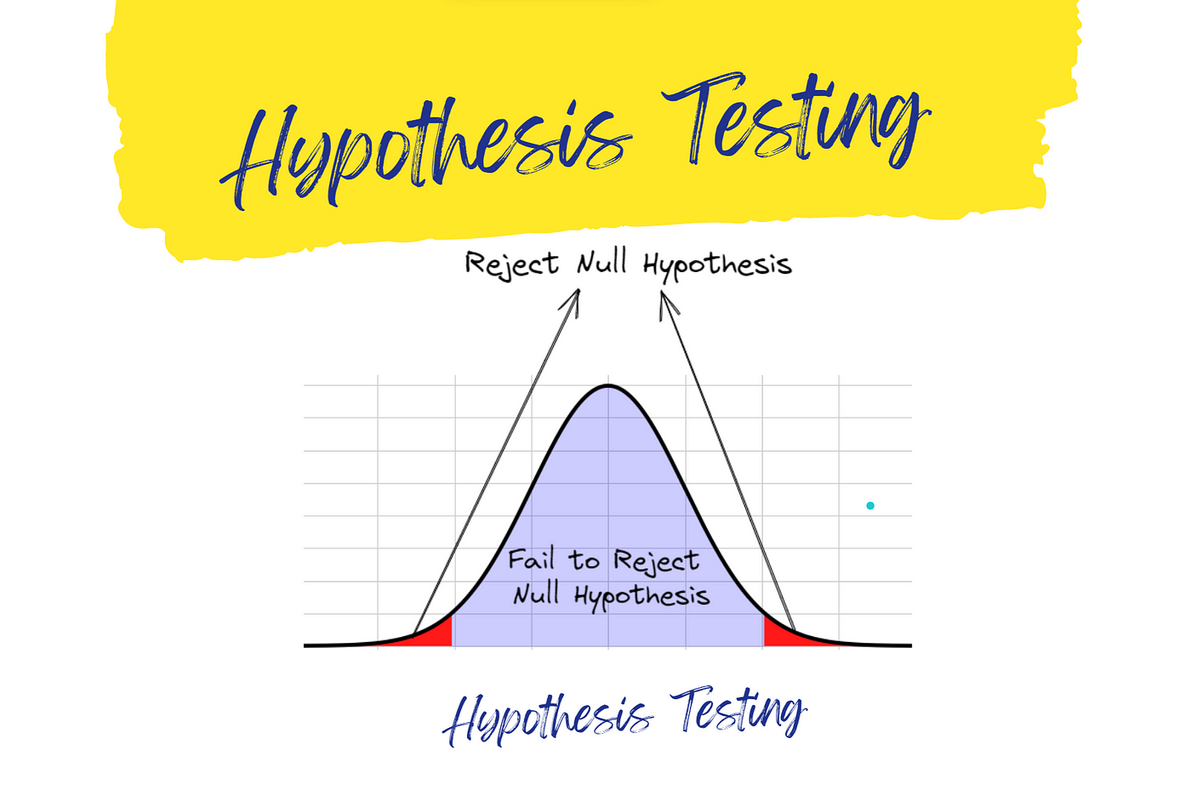
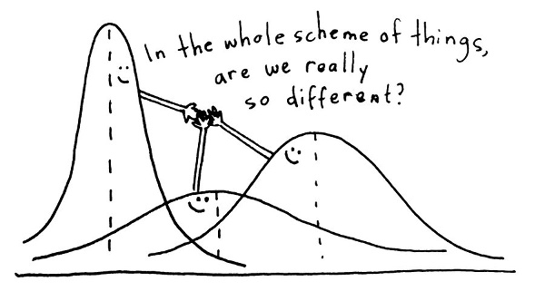
Next Step
ANOVA Testing
Model Tuning:
Hyperparameter Optimization: Use techniques like Grid Search or Random Search to find the best hyperparameters for your models.
Ensemble Methods: Consider using ensemble methods to combine the strengths of different models and improve overall performance.

Slide 11
Questions?

